Slide 1
Team Rebellion
Barış Güvercin
Burak Çelik
Eren Deniz Çelebi
Taylan Doğan

Slide 2
Agenda
Process Details
Difficulties
Finished Components
What is next?

Slide 3
Process Details
Services
Map (http://map.metu.edu.tr/)
Food
Calendar
Community
Transportation (http://ring.metu.edu.tr/)
Schedule (http://sekizkirk.com)

Slide 4
Difficulties
Lack of middle layer
Adaptation
Cafeteria Image Sizes
Navigation for Map API

Slide 5
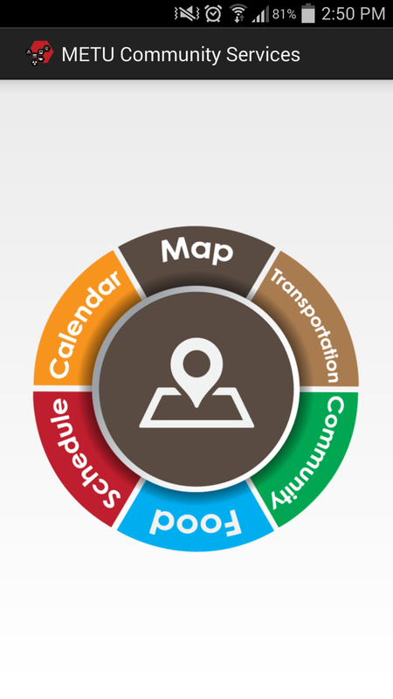
Main Menu

Slide 6
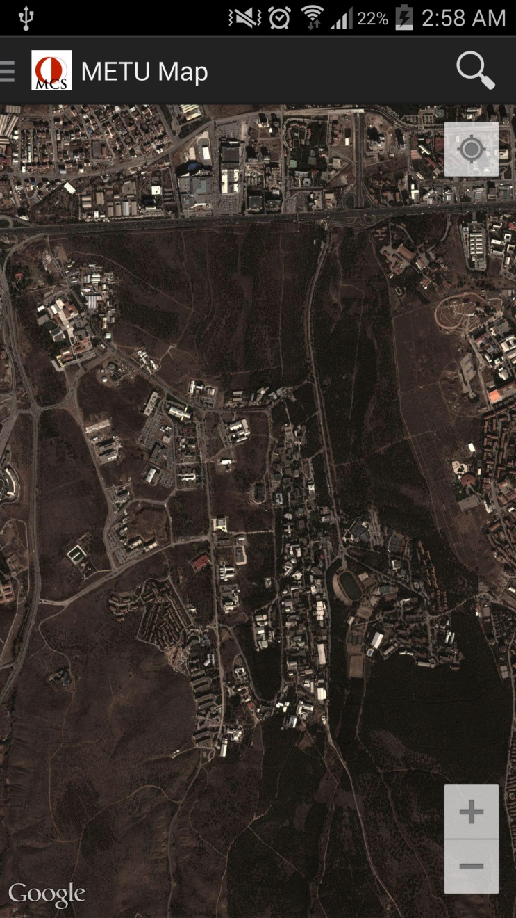
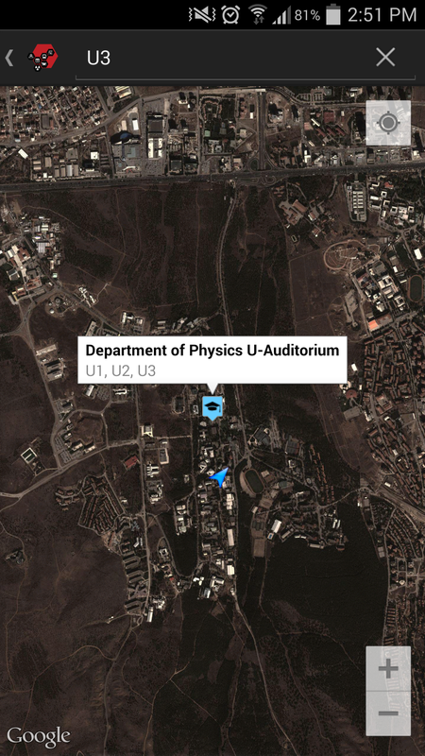
Finished Components

Slide 7
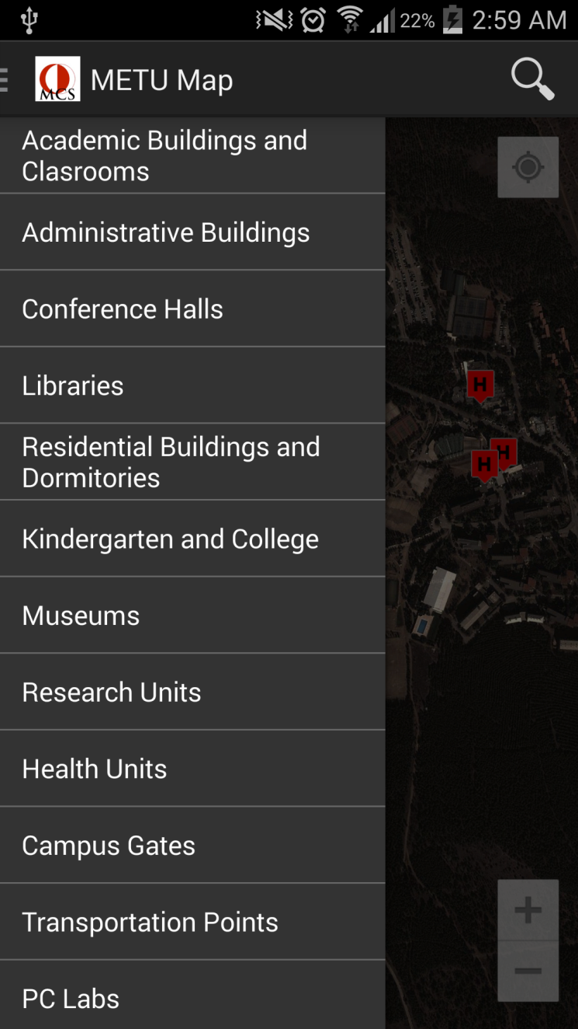
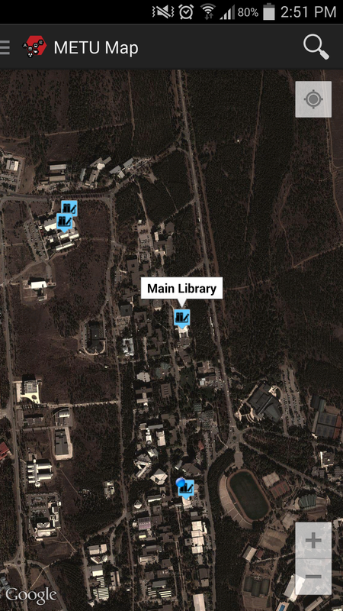
Finished Components

Slide 8
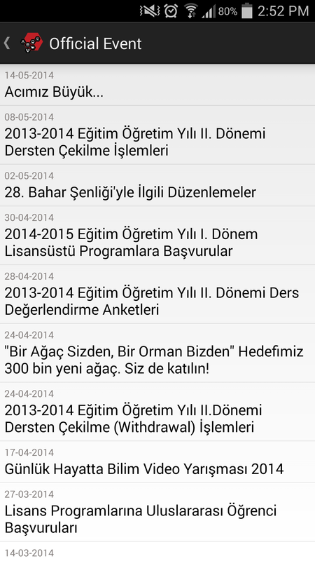
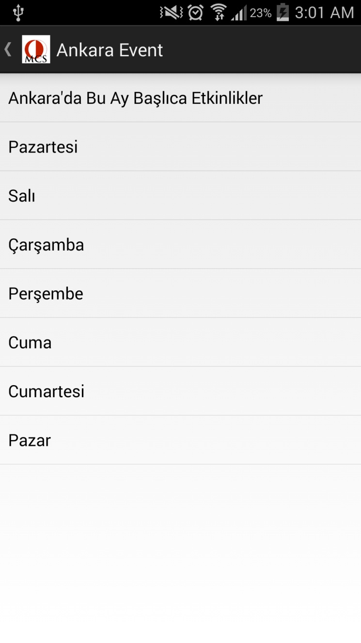
Finished Components

Slide 9
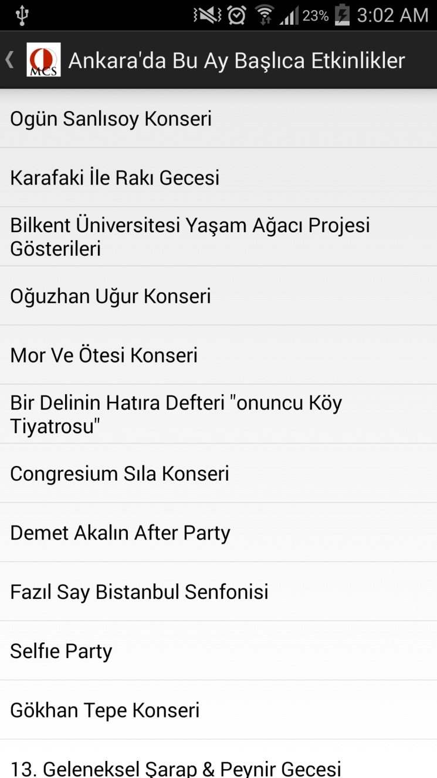
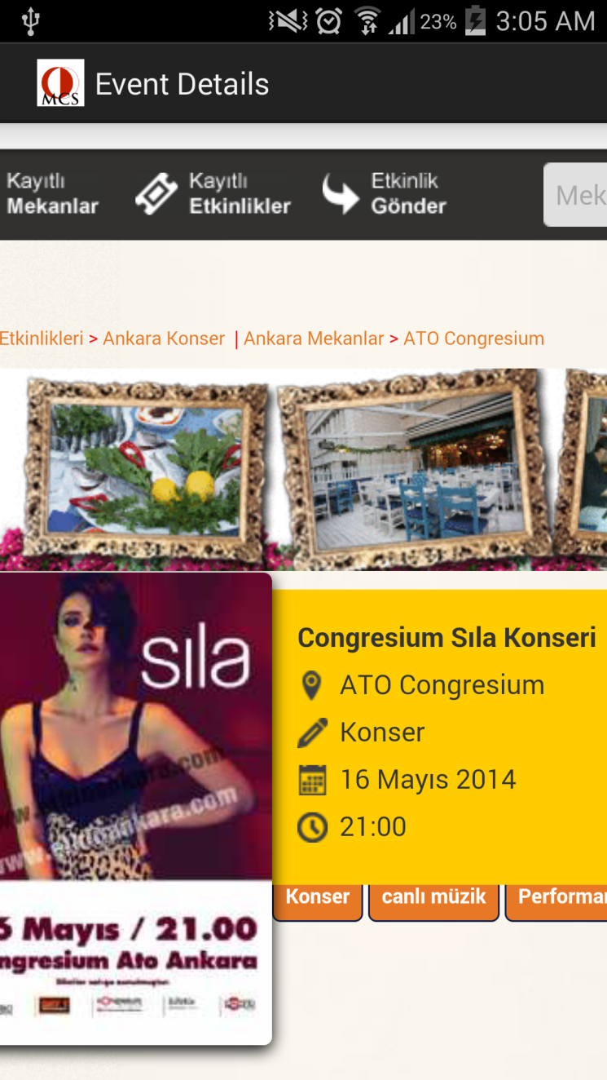
Finished Components

Slide 10
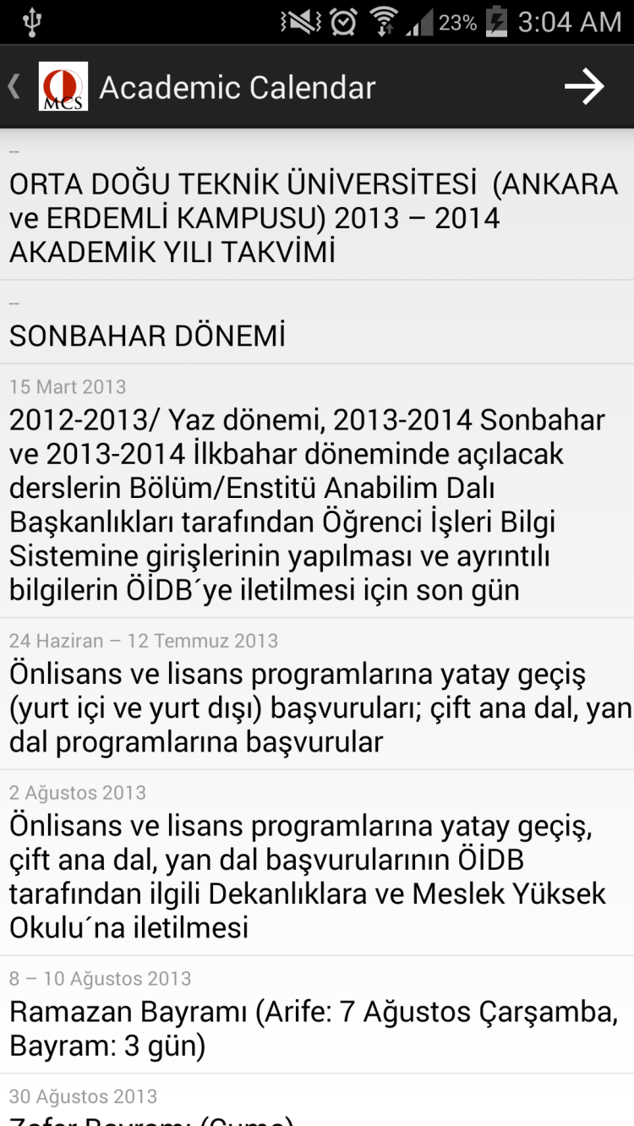
Finished Components

Slide 11
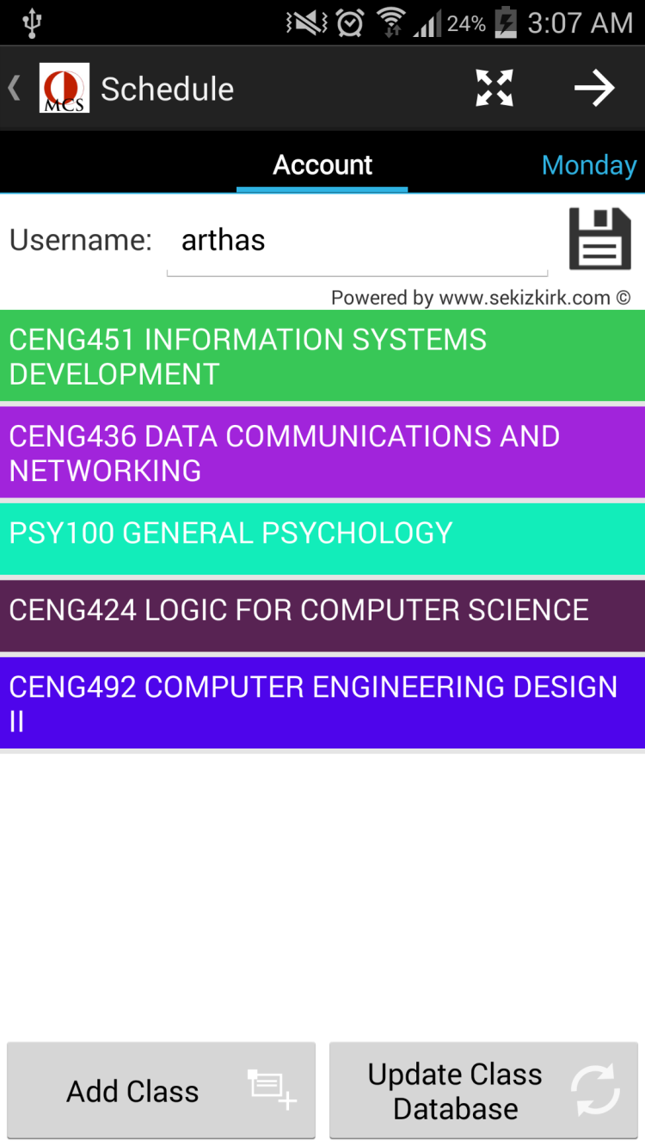
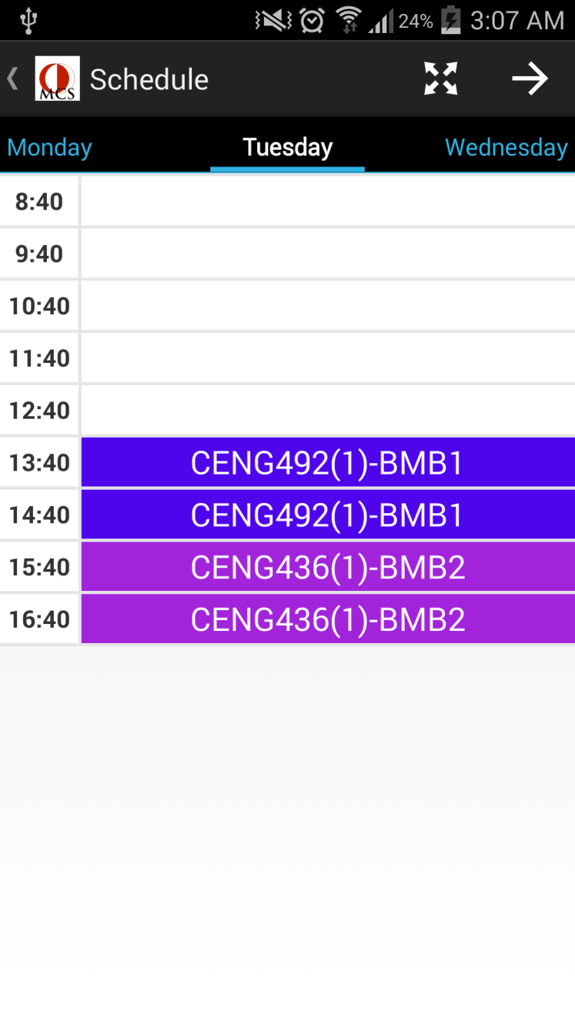
Finished Components

Slide 12
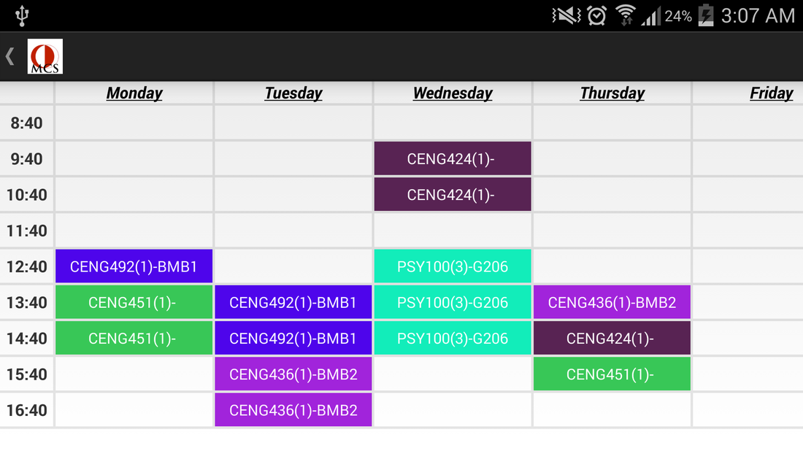
Finished Components

Slide 13
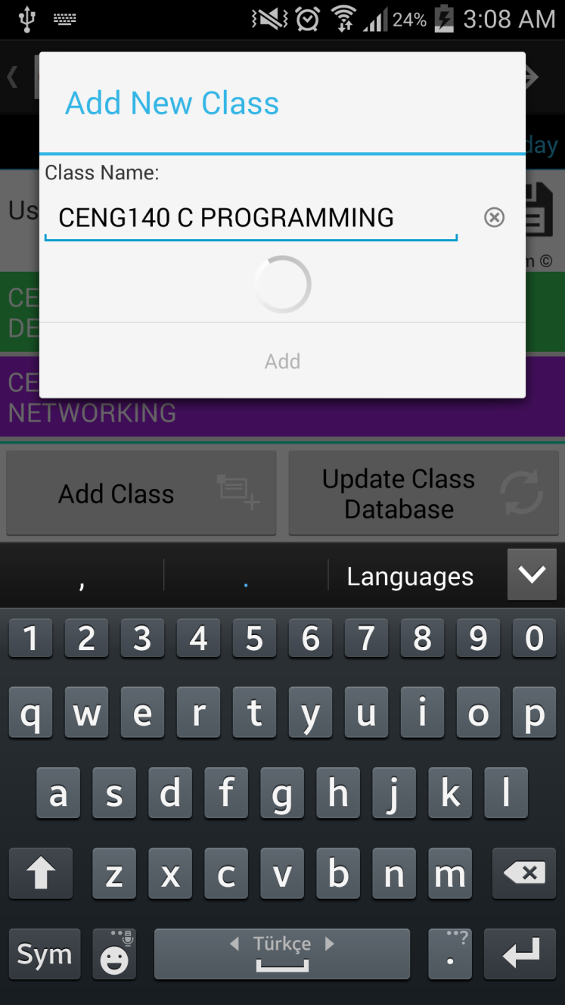
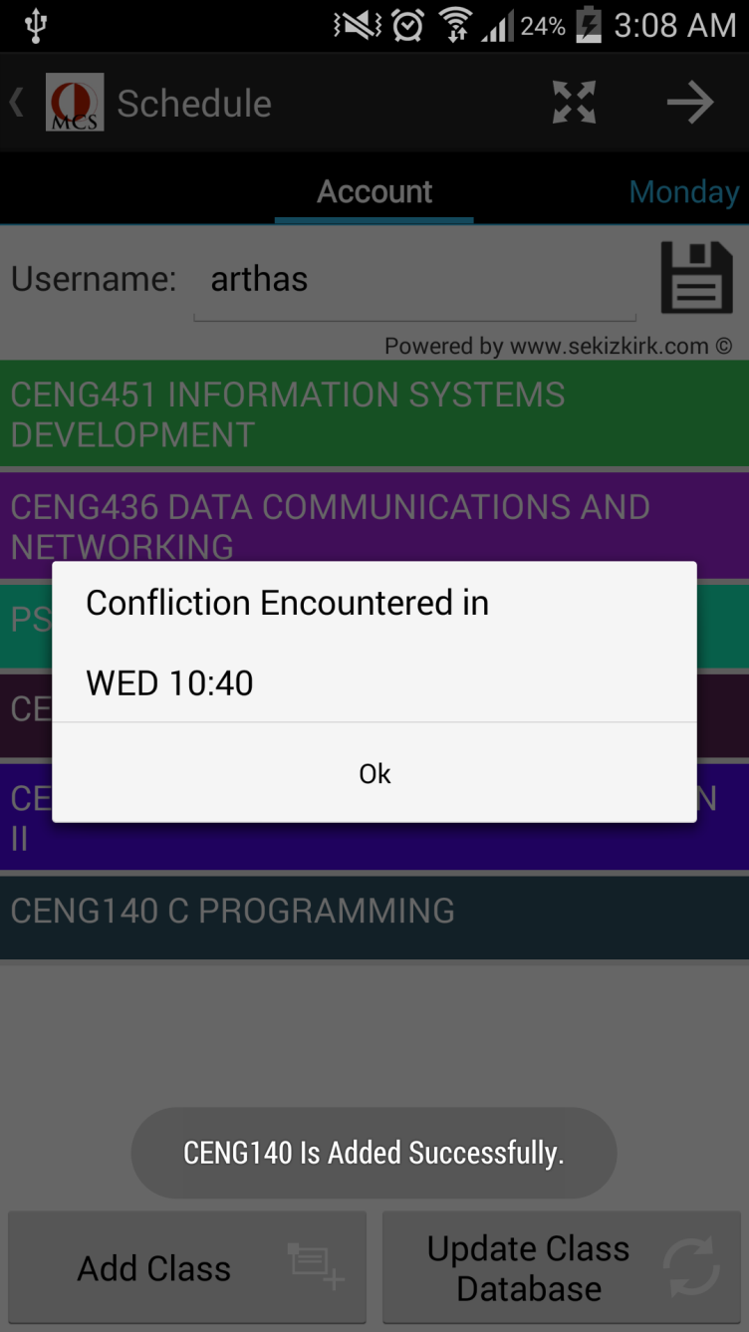
Finished Components

Slide 14
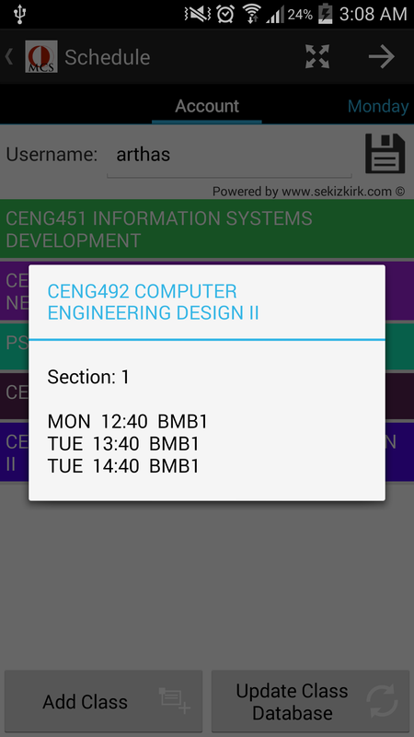
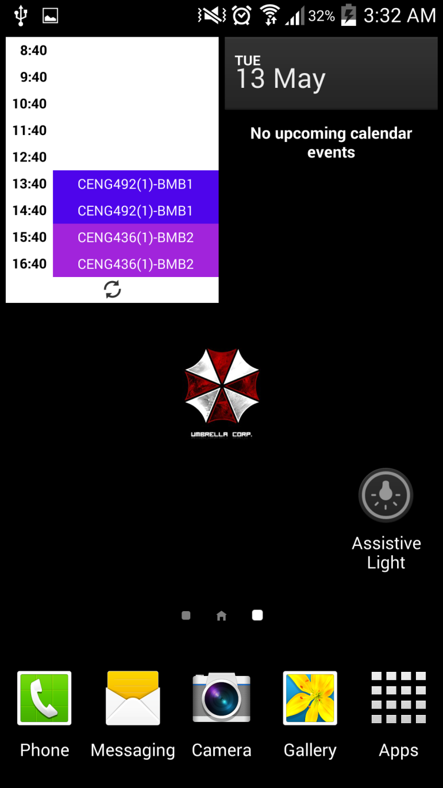
Finished Components

Slide 15
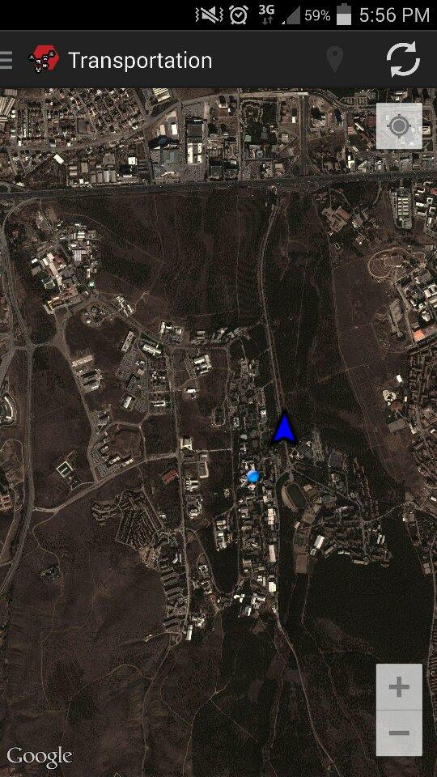
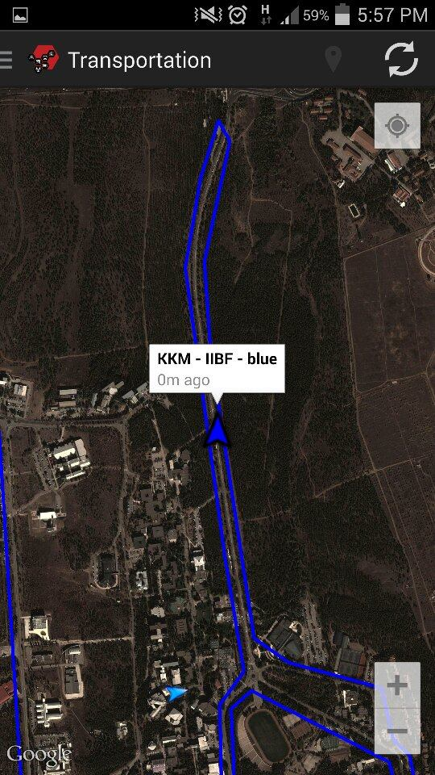
Finished Components

Slide 16
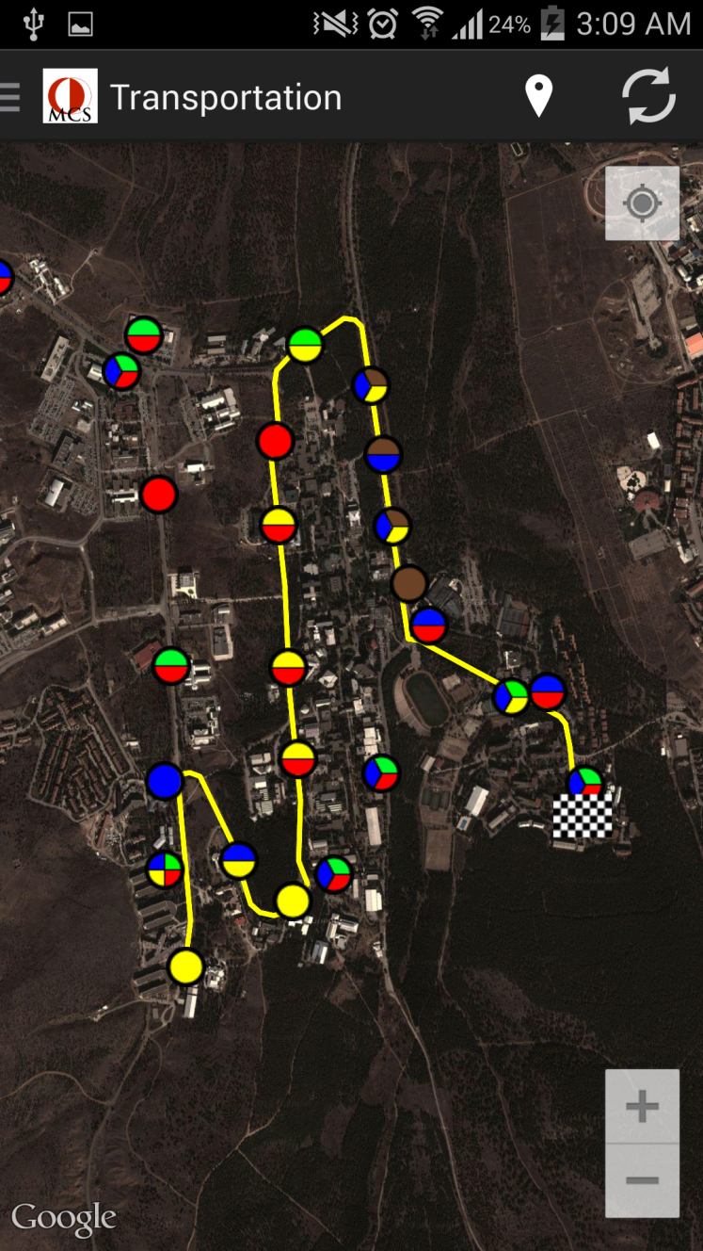
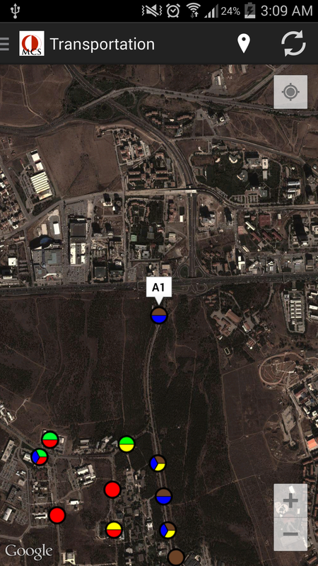
Finished Components

Slide 17
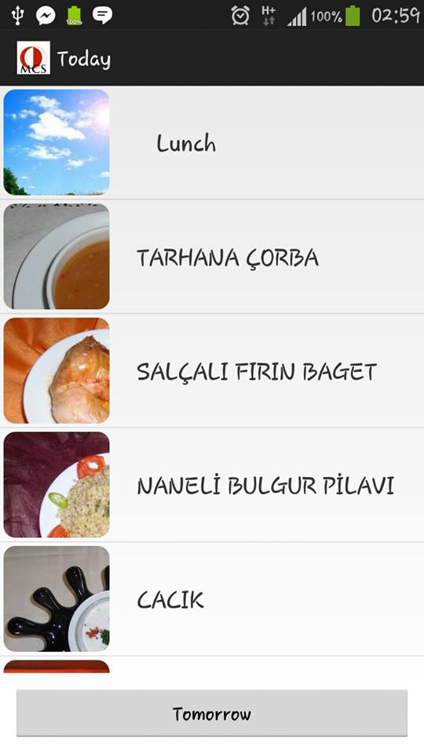
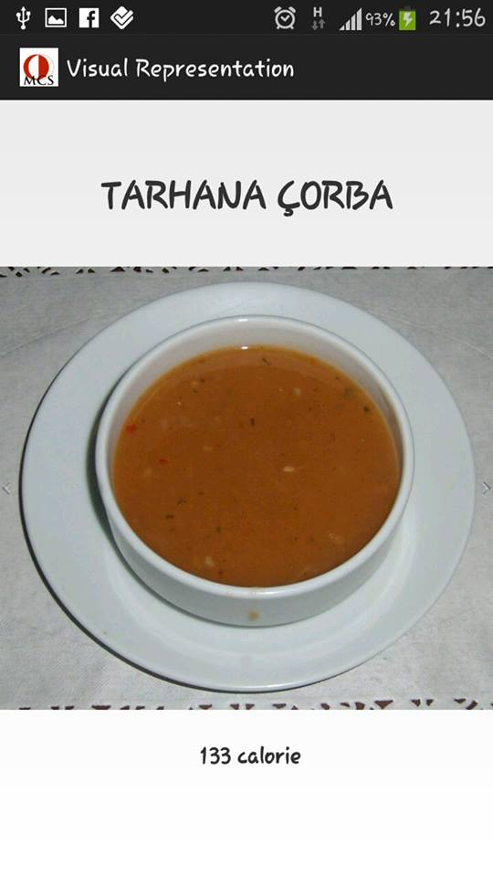
Finished Components

Slide 18
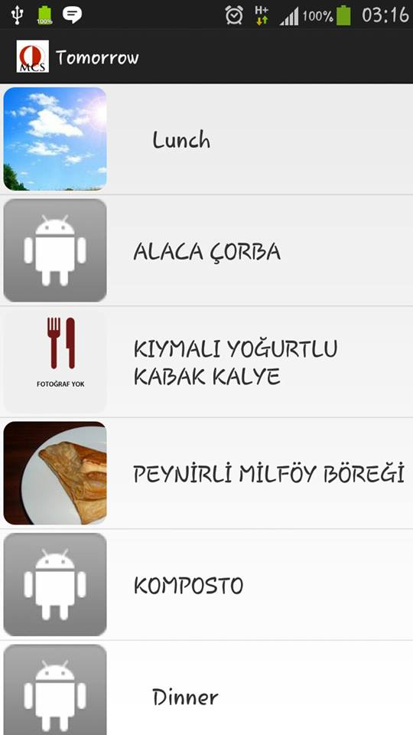
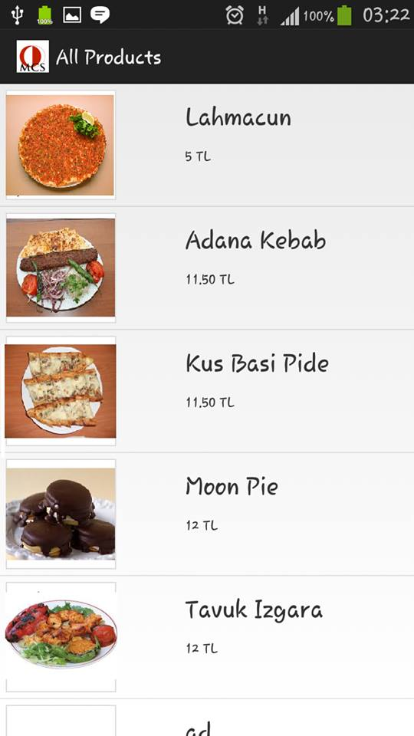
Finished Components

Slide 19
What is next?
Community Component
Other GUI Improvements

